Slide 1
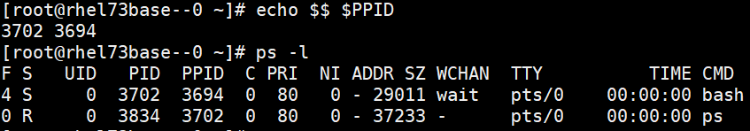
Linux Process Management
Process:
What is a process?
PID and PPID for a process : $$ and $PPID

Slide 2
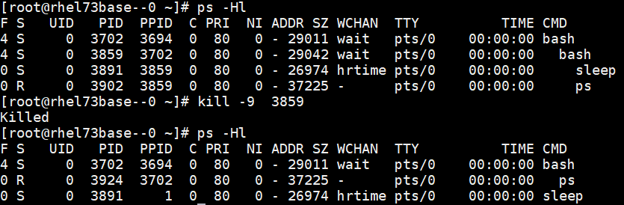
Types of process : init, Orphaned, Daemon and Zombie
Eg. of orphaned process

Slide 3


ps command:
Used for listing out the currently running processes
Commonly used ps options are -a, -u, -x, -e, f, -l, -H, --forest,
pstree, top
pidof cmd_name, ps –C cmd_name , pgrep –l cmd_name

Slide 4
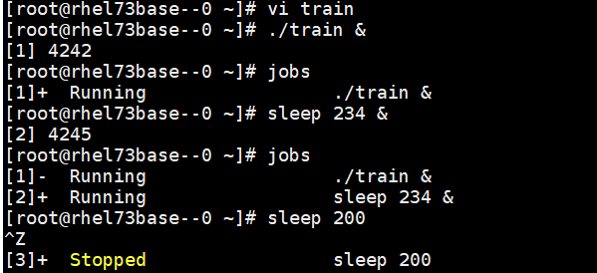
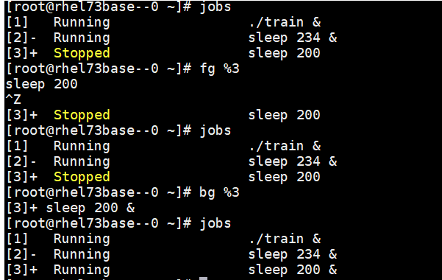
Background and Foreground Process:
Listing all the jobs with “jobs” command.
Make a background process with “&” symbol.
bg [%num] : Background a suspended process.
fg [%num] : Foreground a background process.

Slide 5
Process Priorities
Using “nice” and “renice” commands to set or change the priority of a command.
renice (+-)value pid
nice –value command ,(used when we start the process)

Slide 6
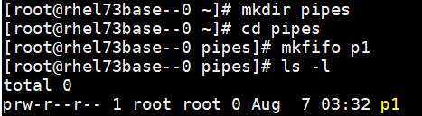


Pipes
mkfifo command is used to make pipes
Terminal 1 Terminal 2

Slide 7
Killing a process
Kill pid
Kill –signal_number pid
Kill –l (lists all the signals)
Pkill command_name or killall command_name

